Slide 1
LeetCode #11 Design Spec
Skip Method

Slide 2
Suppose We Have Found the Max Container
Max!

Slide 3
Can We Have Higher Wall On Left-Hand Side?
?
Max!

Slide 4
No Higher Wall On Left-Hand Side
Otherwise, we would have found a better solution because it would have included the green area
New!

Slide 5

No Higher Walls On Both Sides!
?
?
?
?
?
?
Max!

Slide 6
Skip Shorter Walls
Current Max
…
left
right

Slide 7
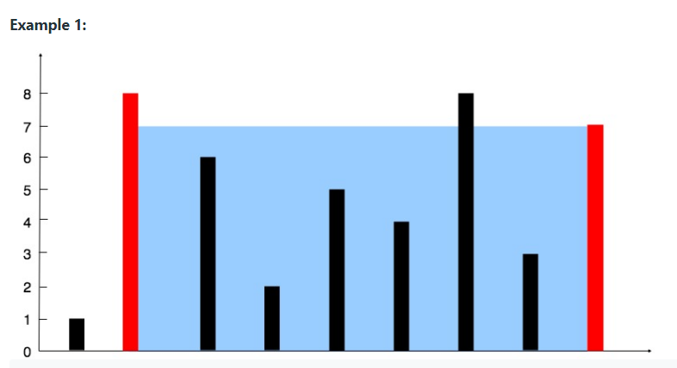

Example: Left to Right
left

Slide 8
Example: Right to Left
right

